Slide 1
KEYLOGGER
CAPSTONE PROJECT
Presented By:
J.RONSIA PATHEES - MOUNT ZION COLLEGE OF ENGINEERING AND TECHNOLOGY - B.E / CSE

Slide 2
OUTLINE
Problem Statement
Proposed System/Solution
System Development Approach
Algorithm & Deployment
Result
Conclusion
Future Scope
References

Slide 3
Problem Statement
Develop a simple keylogger application using Python with a graphical user interface (GUI) to capture keystrokes, save them in both plaintext and JSON formats, and allow users to start and stop the keylogging process.

Slide 4
Proposed Solution
Create a Python script using the Tkinter library for the GUI and the pynput library for capturing keyboard events. Implement functionality to capture keystrokes, save them to files in plaintext and JSON formats, and provide buttons to start and stop the keylogging process.

Slide 5
System Approach
Graphical User Interface (GUI):Use Tkinter to create a window with a label, "Start" button, and "Stop" button.
Keylogging Functionality:Use the pynput library to capture keyboard events (key presses and releases).
File Handling:Create functions to write the captured keystrokes to files in plaintext and JSON formats.
Start and Stop Buttons:Define functions to start and stop the keylogging process.

Slide 6
Algorithm & Deployment
Initialization:
Describes the initialization process where necessary components such as the Tkinter GUI, global variables, and callback functions for keyboard events are set up.
Event Handling:
Explains how the on_press and on_release functions handle keyboard events using the pynput library. These functions are responsible for capturing keystrokes.
Logging:
generate_text_log: Writes the keystroke data to a text file (key_log.txt) in a human-readable format.
generate_json_file: Converts the keys_used list into JSON format and writes it to a file (key_log.json).
Keylogger Control:
start_keylogger: Initiates the keyboard listener using the keyboard.Listener class from the pynput library.

Slide 7
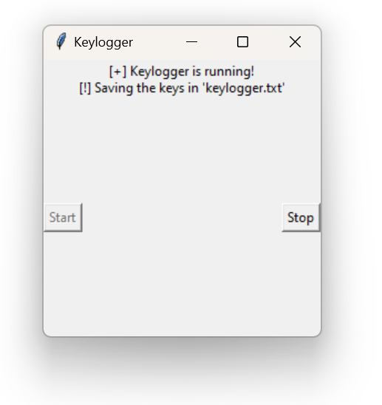
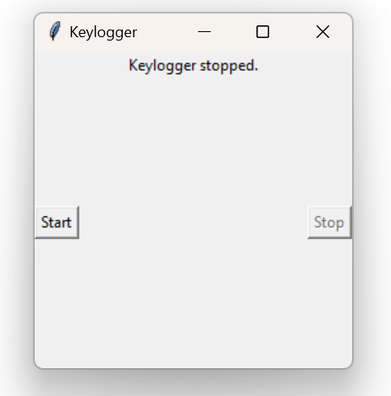
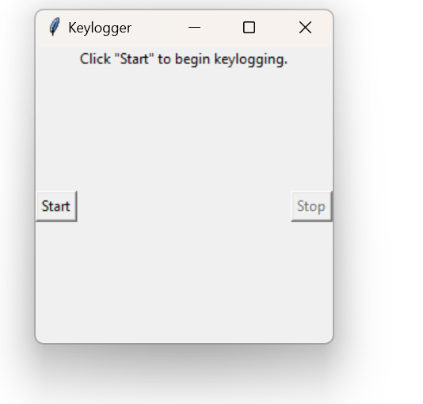
Result
The keylogger application will launch a GUI window with "Start" and "Stop" buttons. Users can click the "Start" button to begin capturing keystrokes, and the captured keystrokes will be saved to key_log.txt and key_log.json. Clicking the "Stop" button will stop the keylogging process.

Slide 8
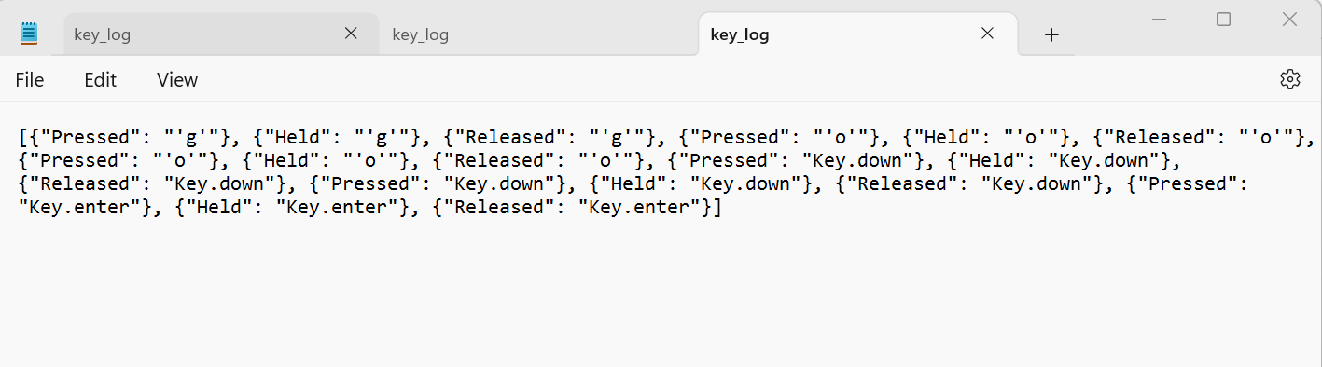
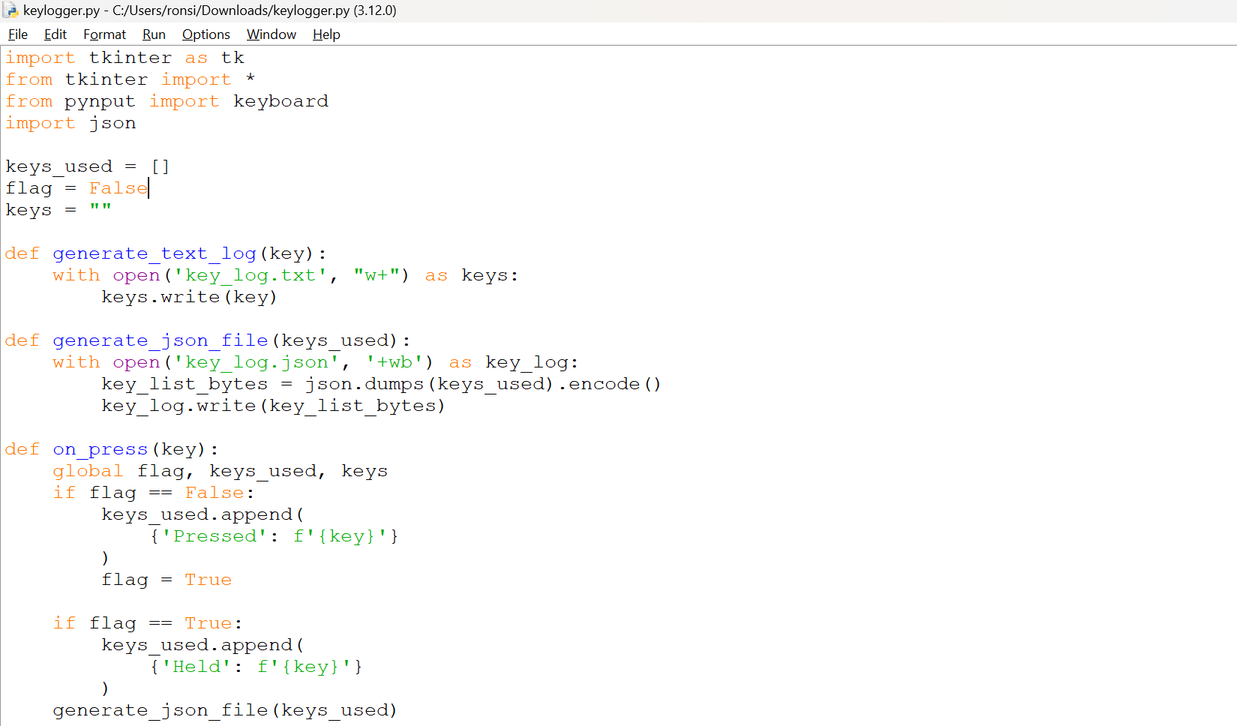
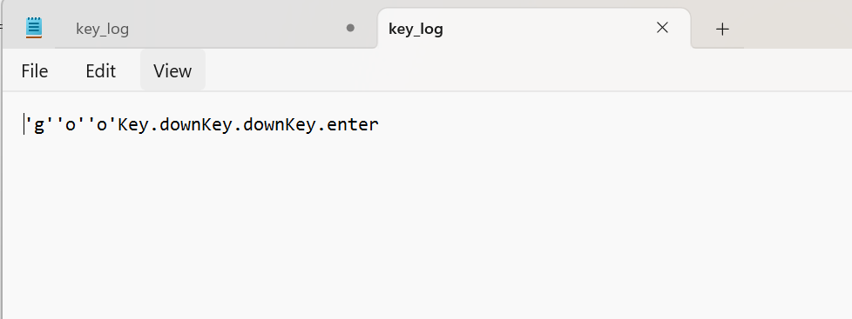
OUTPUT

Slide 9
Conclusion
The developed keylogger application successfully captures keystrokes and provides a user-friendly interface for starting and stopping the keylogging process. It effectively saves captured keystrokes in both plaintext and JSON formats.

Slide 10
Future scope
Enhance the GUI with additional features and customization options.
Implement encryption to secure the captured keystrokes.
Add remote monitoring capabilities to access captured keystrokes from another location.
Implement filtering to capture keystrokes for specific applications or windows.
Improve error handling and add logging for debugging purposes.

Slide 11
References
Tkinter Documentation: https://docs.python.org/3/library/tkinter.html
pynput Documentation: https://pynput.readthedocs.io/en/latest/

Slide 12
THANK YOU

